Slide 1
Embedded Systems with ARM Cortex-M Microcontrollers in Assembly Language and C
Chapter 11
Timer and PWM
Exercises ANS
Z. Gu
Fall 2025
Acknowledgement: Lecture slides based on Embedded Systems with ARM Cortex-M Microcontrollers in Assembly Language and C, University of Maine https://web.eece.maine.edu/~zhu/book/

Slide 2
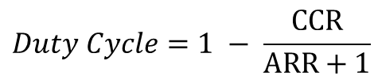

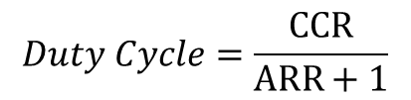
Summary of Equations
Timer clock frequency $f_{CK_CNT}$ vs. CPU Clock Frequency $f_{SOURCE}$
$$f_{CK_CNT}=\frac{f_{SOURCE}}{PSC+1}$$
Timer frequency $fTimer$ with up-counting or down-counting mode:
$$fTimer=\frac{f_{CK_CNT}}{ARR+1}; Timer Period=\frac{ARR+1}{f_{CK_CNT}}= \left(ARR+1\right)∗Clock Period$$
Timer frequency $fTimer$ with center-aligned counting mode:
$$fTimer=\frac{f_{CK_CNT}}{2∗ARR};Timer Period=\left(2∗ARR\right)∗Clock Period$$
PWM duty cycle for Mode 1 (Low-True):
$$Duty Cycle=\frac{CCR}{ARR+1}$$
PWM duty cycle for Mode 2 (High-True):
$$Duty Cycle=1 − \frac{CCR}{ARR+1}$$

Slide 3
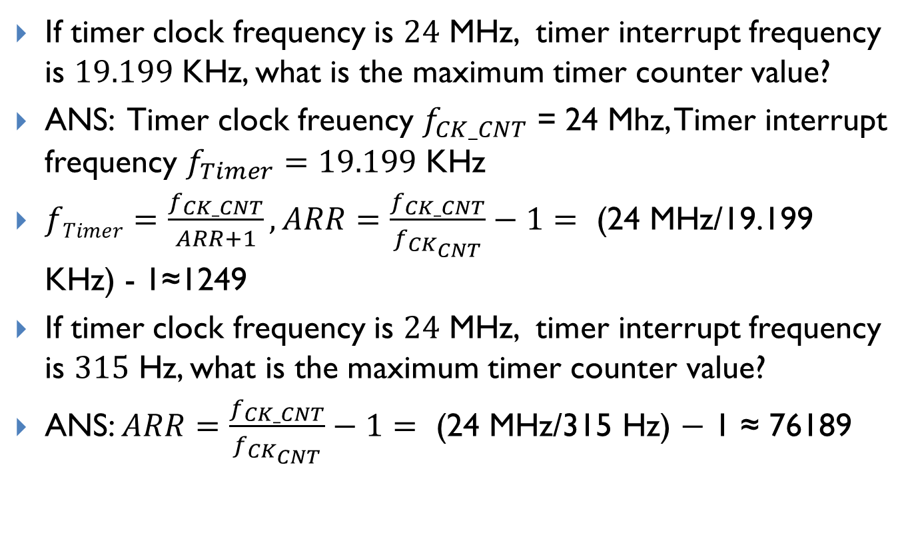
Maximum timer counter value
If timer clock frequency is $24$ MHz, timer interrupt frequency is $19.199$ KHz, what is the maximum timer counter value?
ANS: Timer clock freuency $f_{CK_CNT}$ = 24 Mhz, Timer interrupt frequency $f_{Timer}=19.199$ KHz
$fTimer=\frac{f_{CK_CNT}}{ARR+1}, ARR=\frac{f_{CK_CNT}}{f_{CK_{CNT}}}−1=\text{ (24 }\text{MHz}\text{/19.199 }\text{K}\text{Hz}\text{) - 1≈124}\text{9}$
If timer clock frequency is $24$ MHz, timer interrupt frequency is $315$ Hz, what is the maximum timer counter value?
ANS: $ARR=\frac{f_{CK_CNT}}{f_{CK_{CNT}}}−1=\text{ (24 }\text{MHz}\text{/315 }\text{Hz}\text{) − 1 ≈} \text{76189}$

